Slide 1
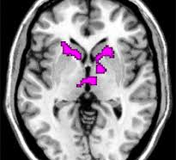


Striatum Reward Psychopathology

Slide 2

The Team
(G)Anna Davydkova
26 yearsold
No programming experience prior to this course
Bachelors in Psychology
(Ya)Kira Kossowsky
25 yearsold
No programming experience prior to this course
Bachelors in Psychology

Slide 3
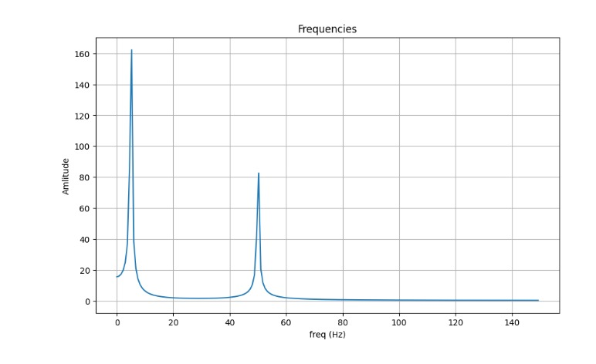
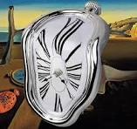
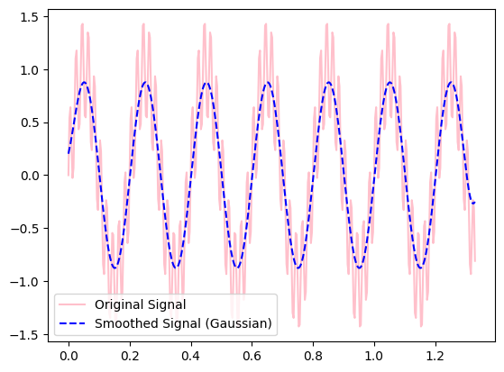
Time series signals

Slide 4

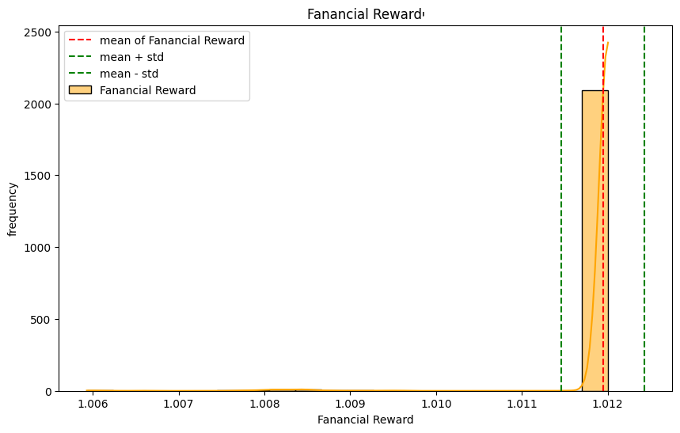
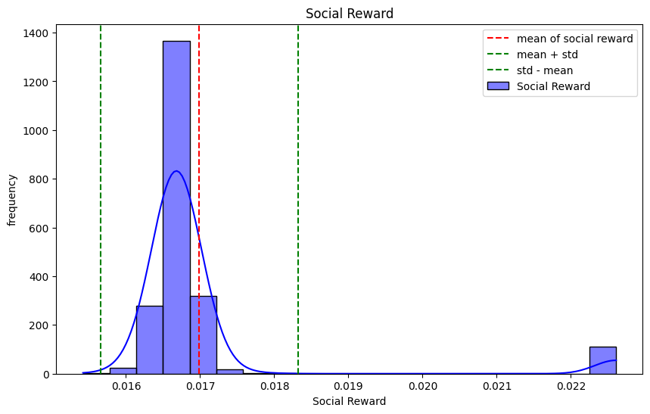
Time series measures of central tendencies

Slide 5
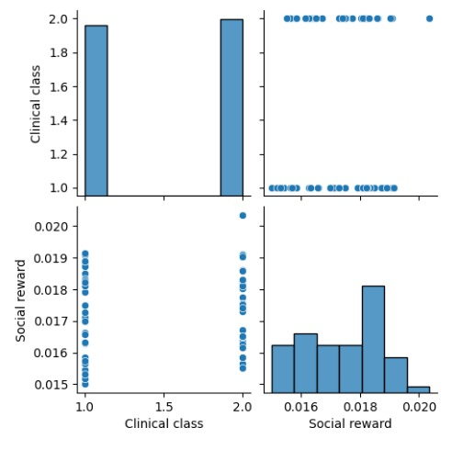
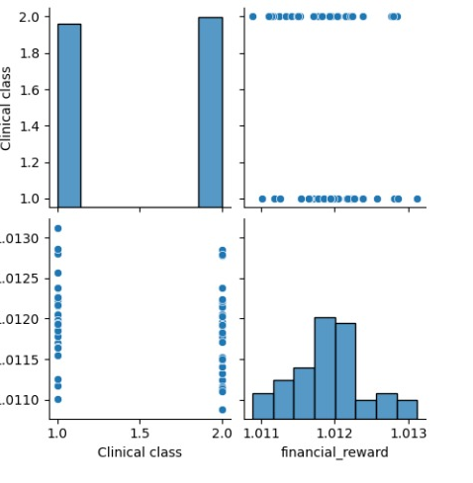

T-test results

Slide 6
In summary
We explored the data set
Came up with an awesome hypothesis
Analyzed the data to the point where it felt gaslit
Re-analyzed the data because we felt gaslit
Realized our awesome hypothesis is correct
(As much as a correlative study can prove)
Made pretty graphs
Called it a day

